Slide 1
Artworks which capture the human experience

Slide 2
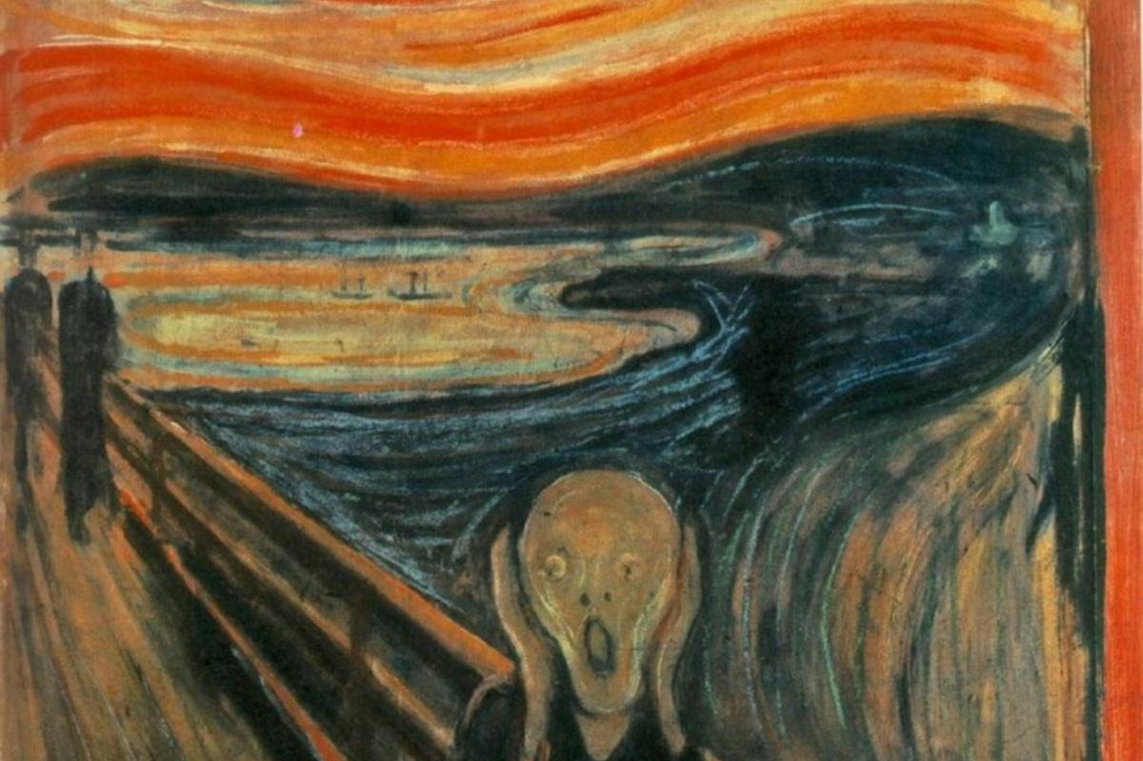
‘The Scream’ Edvard Munch

Slide 3
‘Guernica’ Pablo Picasso

Slide 4
Wanderer above a sea of fog
Casper David Freidrich

Slide 5
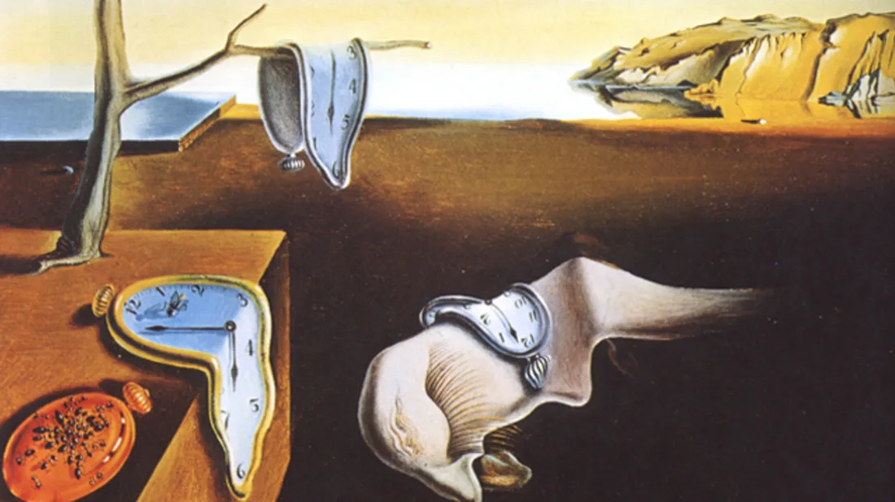
‘The Persistence of memory’ Salvatore dali

Slide 6
‘Impression, sunrise’ Claude Monet

Slide 7
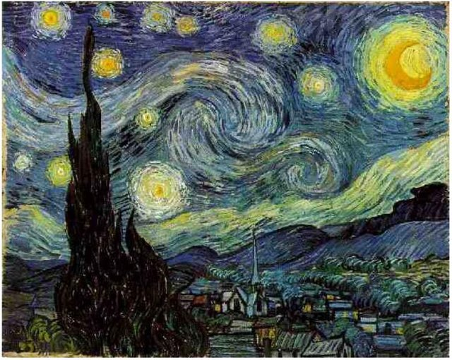
‘Starry Night’ Pablo picasso

Slide 8
Activities
Students are allocated a famous painting to study
In groups students brainstorm insights and key features of the painting
Students then research some critical analysis of the painting
Students report their findings back to the class explaining the way the artist comments on the nature of human experience in his artwork.

