Slide 1
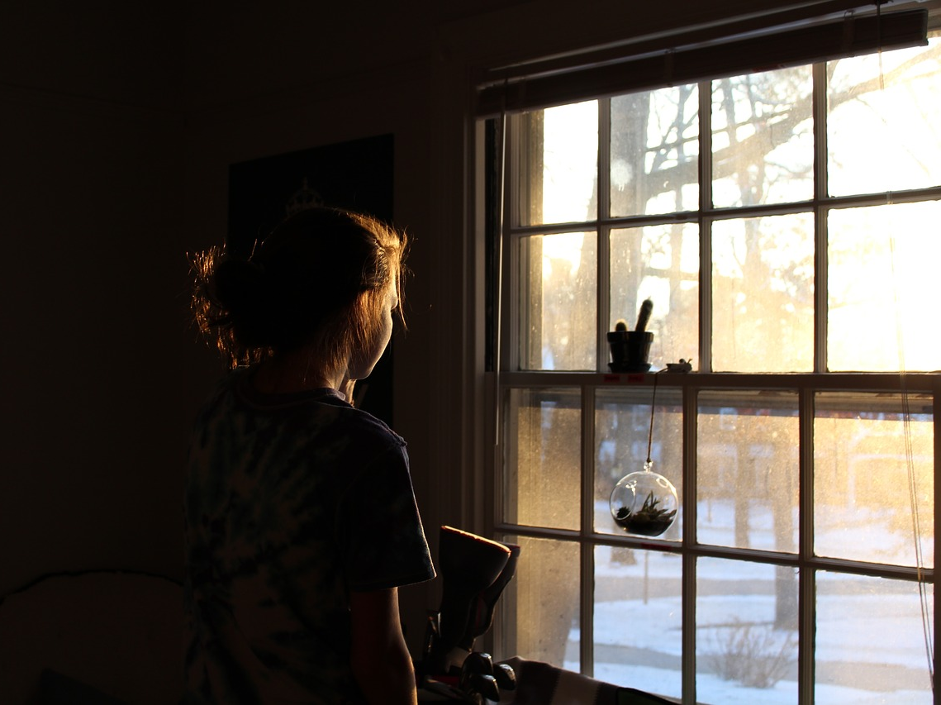
Chapter 4: Sir Danvers Carew
A maid is looking out of her window and sees two people walking up to each other. One is handsome and tall, the other is Hyde.
If one man is murdered, how might this affect the entire story? Why?
Notes:
Picture: http://maxpixel.freegreatpicture.com/Window-Contemplate-Lady-Girl-Woman-Back-People-2610027

Slide 2
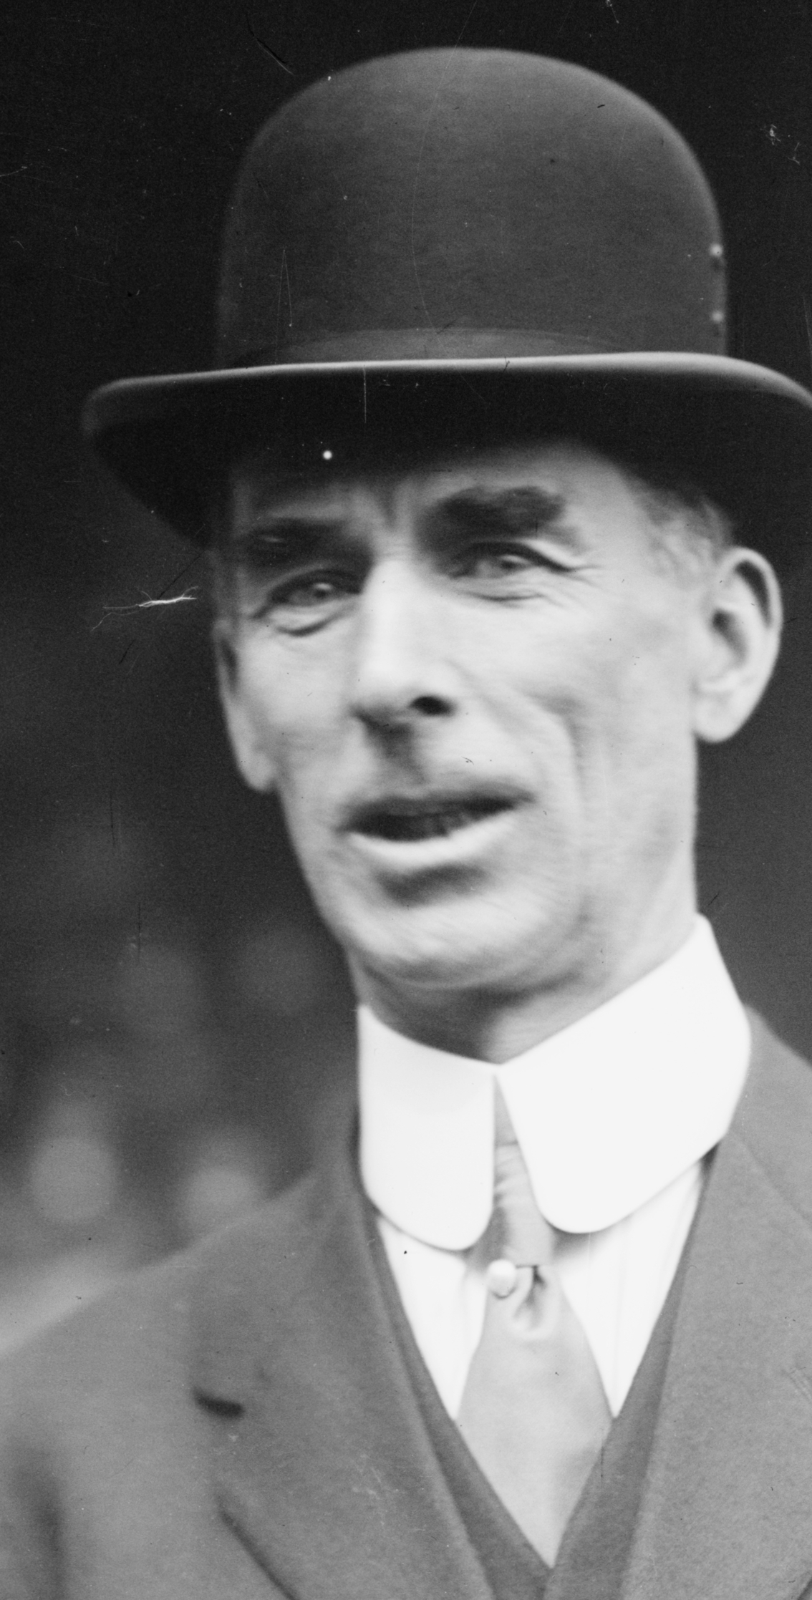
Sir Danvers Carew is murdered by Hyde!
So who exactly was Sir Danvers Carew?
Well, we know he was high up in society given his title of ‘Sir’. This is not an ordinary, common individual. He is also a Member of Parliament. This is someone with a title and therefore importance in Victorian society.
Reputation was very important in Victorian society. Someone like Sir Danvers Carew would have a fantastic reputation given his rank and status in society.
For Hyde to murder him would not just be an ordinary crime, it would be a national scandal.
Compare how people respond to Carew’s murder in response to what happened with the little girl that was trampled on earlier in the text.

Slide 3
Read from the beginning of the chapter up to “I think I can take you to his house”.
Highlight all the words that suggest Sir Danvers Carew is a good and respected person in one colour.
Highlight all the words that suggest Mr Hyde is evil, untrustworthy and savage in a different colour.
Label the techniques the writer uses to build up a very positive image of Sir Danvers Carew and a very negative image of Hyde.
Evaluate how the writer is able to create such a contrast between the two characters in this extract. Refer to specific quotes and techniques in your detailed evaluation.
Techniques to look out for:
Adjectives
Pathetic fallacy
Personification
Metaphor
Simile
Verbs
Adverbs

Slide 4
THE CAREW MURDER CASE
Nearly a year later, in the month of October, 18—, London was startled by a crime of singular ferocity and rendered all the more notable by the high position of the victim. The details were few and startling. A maid servant living alone in a house not far from the river, had gone upstairs to bed about eleven. Although a fog rolled over the city in the small hours, the early part of the night was cloudless, and the lane, which the maid’s window overlooked, was brilliantly lit by the full moon. It seems she was romantically given, for she sat down upon her box, which stood immediately under the window, and fell into a dream of musing. Never (she used to say, with streaming tears, when she narrated that experience), never had she felt more at peace with all men or thought more kindly of the world. And as she so sat she became aware of an aged beautiful gentleman with white hair, drawing near along the lane; and advancing to meet him, another and very small gentleman, to whom at first she paid less attention. When they had come within speech (which was just under the maid’s eyes) the older man bowed and accosted the other with a very pretty manner of politeness. It did not seem as if the subject of his address were of great importance; indeed, from his pointing, it sometimes appeared as if he were only inquiring his way; but the moon shone on his face as he spoke, and the girl was pleased to watch it, it seemed to breathe such an innocent and old-world kindness of disposition, yet with something high too, as of a well-founded self-content. Presently her eye wandered to the other, and she was surprised to recognise in him a certain Mr. Hyde, who had once visited her master and for whom she had conceived a dislike. He had in his hand a heavy cane, with which he was trifling; but he answered never a word, and seemed to listen with an ill-contained impatience. And then all of a sudden he broke out in a great flame of anger, stamping with his foot, brandishing the cane, and carrying on (as the maid described it) like a madman. The old gentleman took a step back, with the air of one very much surprised and a trifle hurt; and at that Mr. Hyde broke out of all bounds and clubbed him to the earth. And next moment, with ape-like fury, he was trampling his victim under foot and hailing down a storm of blows, under which the bones were audibly shattered and the body jumped upon the roadway. At the horror of these sights and sounds, the maid fainted.
It was two o’clock when she came to herself and called for the police. The murderer was gone long ago; but there lay his victim in the middle of the lane, incredibly mangled. The stick with which the deed had been done, although it was of some rare and very tough and heavy wood, had broken in the middle under the stress of this insensate cruelty; and one splintered half had rolled in the neighbouring gutter—the other, without doubt, had been carried away by the murderer. A purse and gold watch were found upon the victim: but no cards or papers, except a sealed and stamped envelope, which he had been probably carrying to the post, and which bore the name and address of Mr. Utterson.
This was brought to the lawyer the next morning, before he was out of bed; and he had no sooner seen it and been told the circumstances, than he shot out a solemn lip. “I shall say nothing till I have seen the body,” said he; “this may be very serious. Have the kindness to wait while I dress.” And with the same grave countenance he hurried through his breakfast and drove to the police station, whither the body had been carried. As soon as he came into the cell, he nodded.
“Yes,” said he, “I recognise him. I am sorry to say that this is Sir Danvers Carew.”
“Good God, sir,” exclaimed the officer, “is it possible?” And the next moment his eye lighted up with professional ambition. “This will make a deal of noise,” he said. “And perhaps you can help us to the man.” And he briefly narrated what the maid had seen, and showed the broken stick.
Mr. Utterson had already quailed at the name of Hyde; but when the stick was laid before him, he could doubt no longer; broken and battered as it was, he recognised it for one that he had himself presented many years before to Henry Jekyll.
“Is this Mr. Hyde a person of small stature?” he inquired.
“Particularly small and particularly wicked-looking, is what the maid calls him,” said the officer.
Mr. Utterson reflected; and then, raising his head, “If you will come with me in my cab,” he said, “I think I can take you to his house.”

Slide 5
The maid is content and happy at this point and seems to find a kind of harmony. This helps to create an atmosphere of peace and prosperity around Sir Danvers Carew, who is described as ‘beautiful’.
This man is associated with “a very pretty manner of politeness.” He is respectful, respected, kind and polite.
Never (she used to say, with streaming tears, when she narrated that experience), never had she felt more at peace with all men or thought more kindly of the world. And as she so sat she became aware of an aged beautiful gentleman with white hair, drawing near along the lane; and advancing to meet him, another and very small gentleman, to whom at first she paid less attention. When they had come within speech (which was just under the maid’s eyes) the older man bowed and accosted the other with a very pretty manner of politeness. It did not seem as if the subject of his address were of great importance; indeed, from his pointing, it sometimes appeared as if he were only inquiring his way; but the moon shone on his face as he spoke, and the girl was pleased to watch it, it seemed to breathe such an innocent and old-world kindness of disposition, yet with something high too, as of a well-founded self-content.
As he speaks, Carew’s face, we are told can “breathe such an innocent and old-world kindness of disposition, yet with something high too”. The moonlight shining on his face and the use of personification to describe his face help to build up an atmosphere of warmth, contentment and peace.

Slide 6
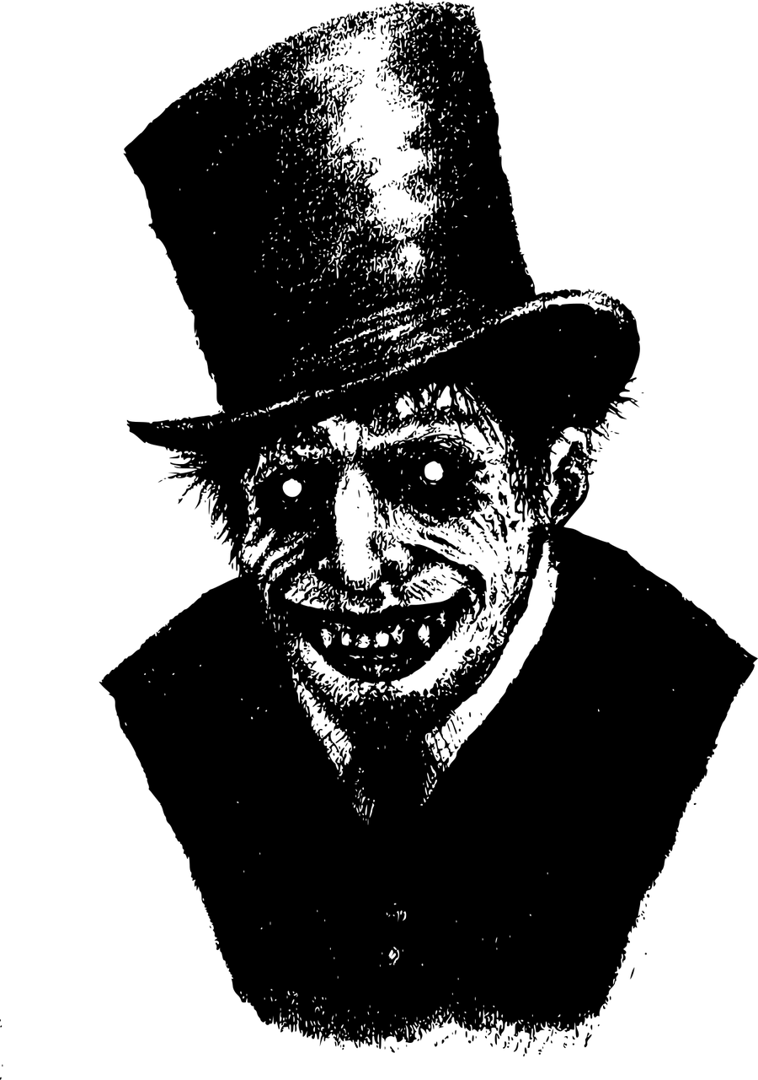
The maid is content moves on to describing Hyde. Notice the contrast in how she describes him: She instantly dislikes him.
Additionally, look at how the maid thinks of Hyde’s appearance: “heavy”, he listens “with an ill-contained peace”. Hyde is the antithesis of the peaceful, patient and respectful Carew.
Presently her eye wandered to the other, and she was surprised to recognise in him a certain Mr. Hyde, who had once visited her master and for whom she had conceived a dislike. He had in his hand a heavy cane, with which he was trifling; but he answered never a word, and seemed to listen with an ill-contained impatience. And then all of a sudden he broke out in a great flame of anger, stamping with his foot, brandishing the cane, and carrying on (as the maid described it) like a madman. The old gentleman took a step back, with the air of one very much surprised and a trifle hurt; and at that Mr. Hyde broke out of all bounds and clubbed him to the earth. And next moment, with ape-like fury, he was trampling his victim under foot and hailing down a storm of blows, under which the bones were audibly shattered and the body jumped upon the roadway. At the horror of these sights and sounds, the maid fainted.
Using the metaphor “a great flame of anger”, the maid sees Hyde’s violence in full flow. Verbs like “stamping”, “brandishing”, “clubbed”, “trampling”, “hailing”, “jumped” all help to accentuate and emphasise Hyde’s violent actions.
Moreover, Hyde’s actions are described as “ape-like” (another Darwin allusion) and the use “like a madman” again helps to illustrate his crazed behaviour.

Slide 7
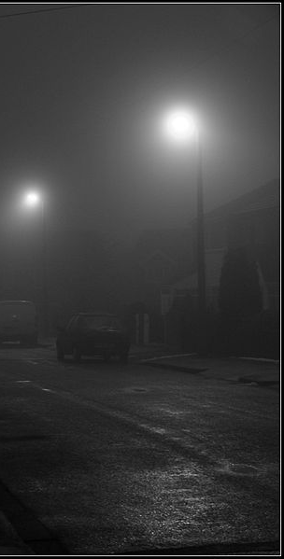
As we read the rest of the chapter, think about the following questions:
1) Why does the writer make the streets so foggy as the police officer and Utterson head towards Hyde’s residence?
2) Think about the way the writer describes Hyde’s residence. What kind of shops do we find there and what kind of people?
3) How are Hyde’s rooms decorated? Why are they like this?
4) How does the description of these settings reflect the gothic literature conventions? How does Stevenson use setting to ‘conceal’?

