Slide 1
Poetry of World War One

Slide 2
How to analyse war poetry:
Is the poem pro-war or anti-war?
How does the poet use language techniques to express their views?
How does the poet’s own context shape meaning?

Slide 3
Guidelines for analysing a poem:
What is the poem about?
What is the subject matter of the poem? Is it describing one event or situation, or many ? You need to only include the main points – don’t try to include too many details.

Slide 4
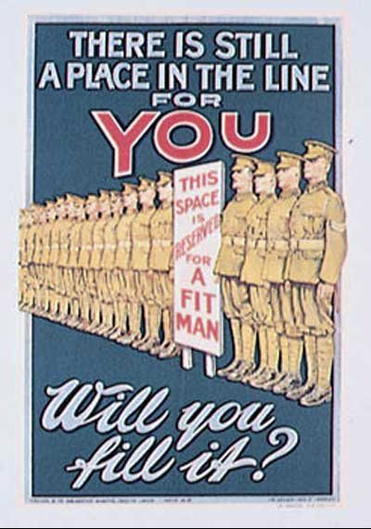
2. What is the theme?
Theme is the main message
expressed, or the poet’s purpose.
Common themes in war poetry
will include: pro or anti-war ideas,
grief, loss and suffering.

Slide 5
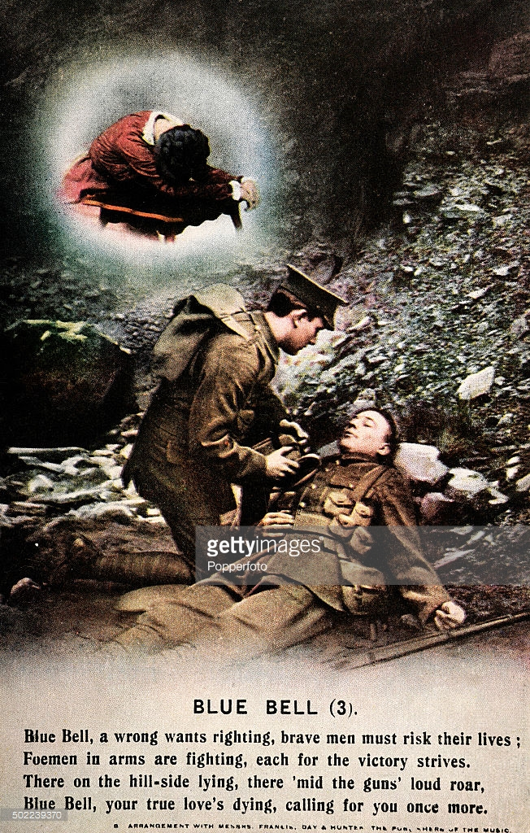
3.What emotions does the poem convey?
Some poems create a very strong mood or atmosphere. A poet who expresses great sorrow, joy or anger can also make the reader feel these too.

Slide 6
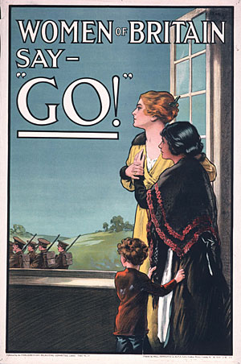
4. Who is the intended audience?
The content and themes of a poem are often more suitable for one type of audience. It is not enough to just say that the audience is everyone, you need to consider the message.

Slide 7
5. What is the form and style?
Different forms of poems help to create a different effect, or convey the message in a more effective way. The main forms in war poetry are ballads, elegies, odes and sonnets.
They style of the language, either formal or informal, can also help to shape meaning.

Slide 8
6. What poetic techniques have been used?
These are the tools that make the poem imaginative and they help the reader to more fully understand the poem, and the poet’s purpose. Techniques can create visual images, or emphasise sound features to bring the words to life in the mind of the reader.

