Slide 1
In Flanders Fields
By John McCrae, May 1915

Slide 2
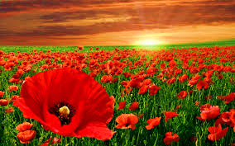
In Flanders fields the poppies blow Between the crosses, row on row, That mark our place; and in the sky The larks, still bravely singing, fly Scarce heard amid the guns below.
We are the Dead. Short days ago We lived, felt dawn, saw sunset glow, Loved and were loved, and now we lie In Flanders fields.
Take up our quarrel with the foe: To you from failing hands we throw The torch; be yours to hold it high. If ye break faith with us who die We shall not sleep, though poppies grow In Flanders fields.

Slide 3
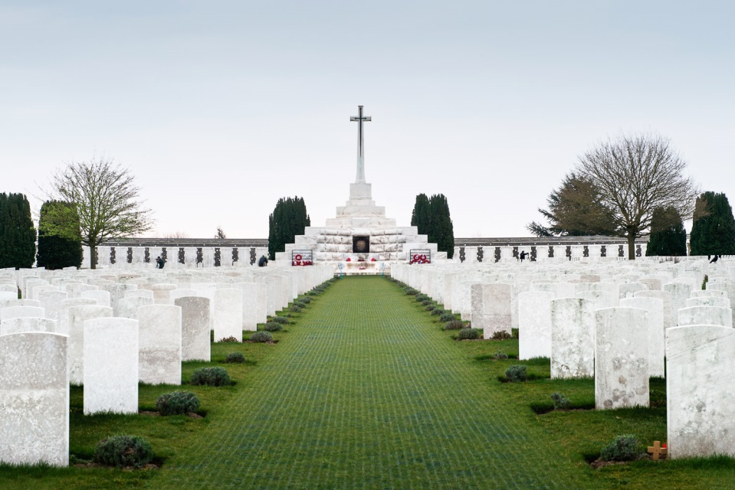
The title of the poem sets a direct place for the events that occurred, however the themes are more universal.
The Flanders region, in Belgium, was the site of the Second Battle of Ypres, where McCrae fought. Over 105,000 soldiers were killed or wounded in this battle. The site is now a massive WW1 Cemetery.
In Flanders Fields

Slide 4
Poppies are a significant symbol in this poem. The flowers only grow in upturned earth, and were widespread on the battle fields. They are symbolic of both life continuing, and also the colour of them (red) is symbolic of the spilled blood of men.
The use of plural here, as well as repetition, provides imagery of the massive scale of death on this field.
Repetition of title emphasises the soft alliteration of the F sounds, adds peaceful tone.
Personal pronoun gives narrative perspective of first person. This poem is written from the voice of the dead.
In Flanders fields the poppies blow Between the crosses, row on row, That mark our place; and in the sky The larks, still bravely singing, fly Scarce heard amid the guns below.
Contrasting imagery of life in the sky to the death on the ground. Emphasised by the emotive personification of ‘bravely’.
Aural imagery of the ongoing battlefield. This is also a metaphor for the soldier’s inability to appreciate signs of life, as they are consumed with the sights and sounds of war and death.

Slide 5
Short sentence emphasises the narrative perspective. Personal pronouns are written in plural form to highlight the number of dead.
Emphasises how quickly life can be taken away, and how fresh the memories of life are.
Images of life are symbolic of what has been lost. There is a metaphor about the cycle of life in the rising and setting of the sun.
Emotive language, in past tense, highlights what has been lost.
We are the Dead. Short days ago We lived, felt dawn, saw sunset glow, Loved and were loved, and now we lie In Flanders fields.
Present tense is in contrast to images of life. Now there is nothing.
Repetition of the title establishes place of final resting site of the dead. It is now a cemetery rather than a battle field.

Slide 6
Direct command to the living to continue fighting. Highlighted through the use of emotive language of ‘quarrel’ and ‘foe’.
Metaphor is used show that the responsibility has passed on to those who are still living. There is strong, negative, emotive language in the word ‘failing’
The tone of the poem shifts here to be much more pro-war.
Torch is metaphorical for both the responsibility of fighting, and of life, as fire is symbolic of life and light.
Take up our quarrel with the foe: To you from failing hands we throw The torch; be yours to hold it high. If ye break faith with us who die We shall not sleep, though poppies grow In Flanders fields.
Metaphor is continued. The living should be proud to keep fighting.
Metaphor. The living must remain faithful to the fight that men died for.
Sleep is used as a metaphor to describe peaceful rest. The dead will not rest in peace if their deaths were for nothing.
Final repetition concludes the poem with direct reference to the place of battle that is now a cemetery.
Symbolism that men will keep dying, and poppies will keep growing on their graves.

Slide 7
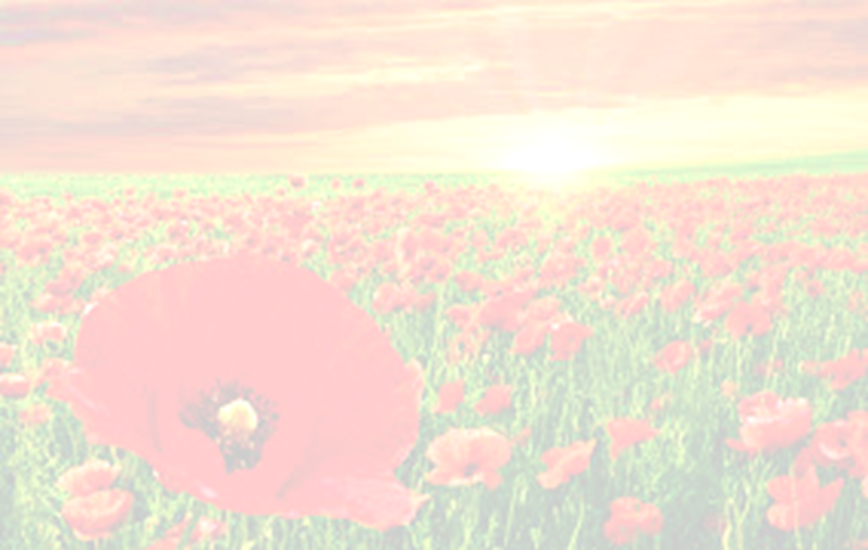
Form and Style:
This poem is written in the form of a French Rondeau poem, which is a very lyrical form of poetry.
It is comprised of three stanzas, and is 15 lines long in total. Lines 9 and 15 are the same – and make a sort of chorus to the short poem. They also rhyme only with each other.
The rest of the lines are made up of 8 syllables.
This is a very formal way to compose a poem, and requires a great deal of thought. The heavy use of symbolism throughout the poem also adds to the formal tone that is created.

Slide 8
In Flanders Fields
 | EXPLAIN | EXAMPLE
About
Themes
Emotions / Mood
Audience
Form / Style
Poetic Devices

