Slide 1
Descartes, Freud, and Jekyll & Hyde
Philosophy, Psychology and the revelation of self.

Slide 2
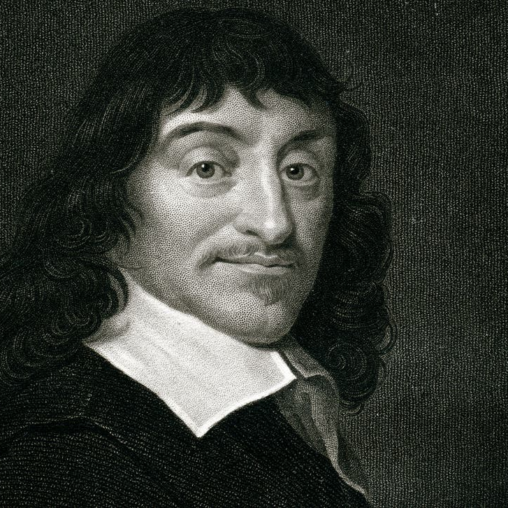
Rene Descartes
Descartes was a French Philosopher (c1641).
He developed a theory known as Substance Dualism, which posits that the human mind is a non-physical substance. He was the first to identify that the mind is associated with consciousness and self-awareness, and that it was separate to the physical brain which he saw as the physical seat of intelligence.
Descartes formulated that the mind and body were separate entities of the human form.

Slide 3
The Argument from Doubt “I think, therefore I am” Descartes discovered that he could doubt whether he had a body but he could not doubt whether he had a mind.
Philosophically, this allowed for the split-self, and the birth of duality in self

Slide 5
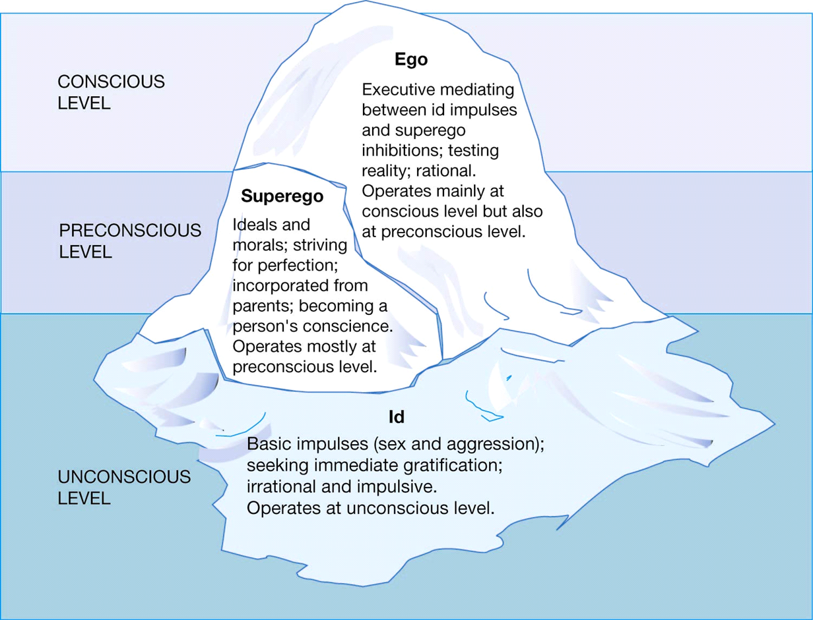
Sigmund Freud
Freud was a psychologist and although his personality theory (1923) came after Jekyll and Hyde was written, it works perfectly with the text.

Slide 6
The id, The ego, The super-ego.
The id – instincts. The disorganized part of the personality structure that contains a human's basic, instinctual drives. It is the source of our bodily needs, wants, desires, and impulses, particularly our sexual and aggressive drives.
The ego – mediates and balances between the id and the super-ego. The ego acts according to the reality principle; i.e., it seeks to please the id's drive in realistic ways that will benefit in the long term rather than bring grief. At the same time, Freud concedes that as the ego "attempts to mediate between id and reality, it is often obliged to cloak the [unconscious] commands of the id with its own preconscious rationalizations, to conceal the id's conflicts with reality,
The super-ego – cultural regulation. The super-ego reflects the internalization of cultural rules, mainly taught by parents applying their guidance and influence. Can also be seen as societies rules and expectations. It criticizes and prohibits their drives, fantasies, feelings, and actions. "The Super-ego can be thought of as a type of conscience that punishes misbehaviour with feelings of guilt.

