Slide 1
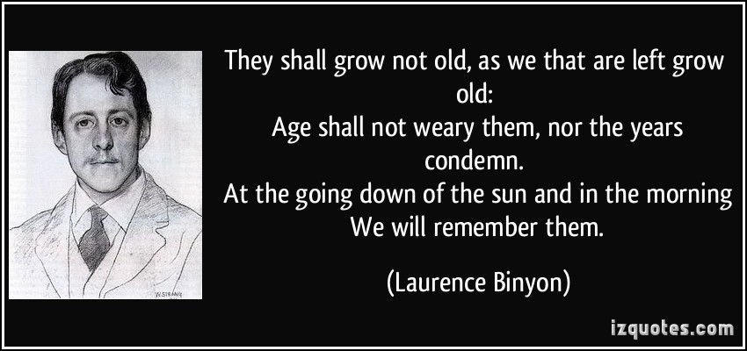
Robert Laurence Binyon
1869 - 1943

Slide 2
Early life
10th August, 1869 – 10th March, 1943.
A poet, a dramatist and an academic
His most famous work, For The Fallen, is well known for being used across the world in remembrance services.
He was born in England, and his father was an engineer on the British railway.
His family were very religious.

Slide 3
Binyon studied at St Paul’s School in London and then attended Oxford University where he won a prize for poetry in 1891.
When he graduated in 1893 he started working for the Department of Printed Books for the British Museum.
He published his first book in 1895.
In 1904 he got married, and he and his wife went on to have three daughters.
He was close friends with many artists and writers.

Slide 4
For The Fallen
Binyon was visiting the coast of England in 1914 when he wrote the poem, including it’s Ode of Remembrance. He was deeply affected by the opening of the Great War and at the already high number of British casualties as part of the British Expeditionary Force.
Today, the poem is recited at services to honour the war dead across the United Kingdom. It is also an important part of Anzac Day services in both Australia and New Zealand, and on Armistice Day in Canada.

Slide 5
Experiences of war
Binyon was too old to enlist to fight in World War One, however in 1915 he volunteered at a British hospital in France that treated wounded French soldiers.
In 1916 he returned to England and continued to work as a volunteer in hospitals that looked after the most severely injured men on their return from the battlefields.
After the war
Binyon returned to his work at The British Museum until 1933 when he was appointed a Professor of Poetry at Harvard University . He went on to continue working as an academic at Harvard and Oxford, and in 1940 he was appointed as a Professor of English Literature at the University of Athens.

Slide 6
Death
Binyon died following complications from surgery in March, 1943.
In November, 1985 he was among 16 Great War poets commemorated on a stone in Westminster Abbey’s Poets’ Corner. The inscription on the stone quotes a fellow Great War poet, Wilfred Owen. It reads: “My subject is war, and the pity of war. The poetry is the pity.”
It is his poem that is the most well recognised of the war poems that we have studied.

