Slide 1
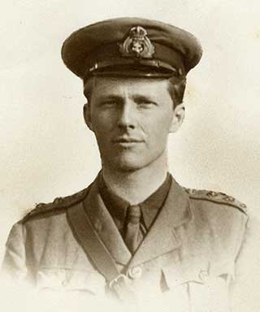
Rupert Brooke
1887 - 1915

Slide 2
Biography and Context:
Born August 3rd, 1887.
As a child he excelled in both academics and athletics.
Won the school poetry prize in 1905, at the age of 18.
At Cambridge University, he was known for his good looks, charm and intellect, and was very popular.

Slide 3
Poetry and the Arts:
Published his first book of poems in 1909.
In 1912 he left England to travel through France and Germany, where he was inspired to write romantic style poetry.
Critics viewed Brooke’s poetry as too sentimental and lacking in depth, however they also acknowledged that they were an accurate representation on Pre-WW1 feeling.
Brooke suffered a mental breakdown in 1913, following which he travelled to America and Canada. He wrote essays and poems that were not published until 1916.

Slide 4
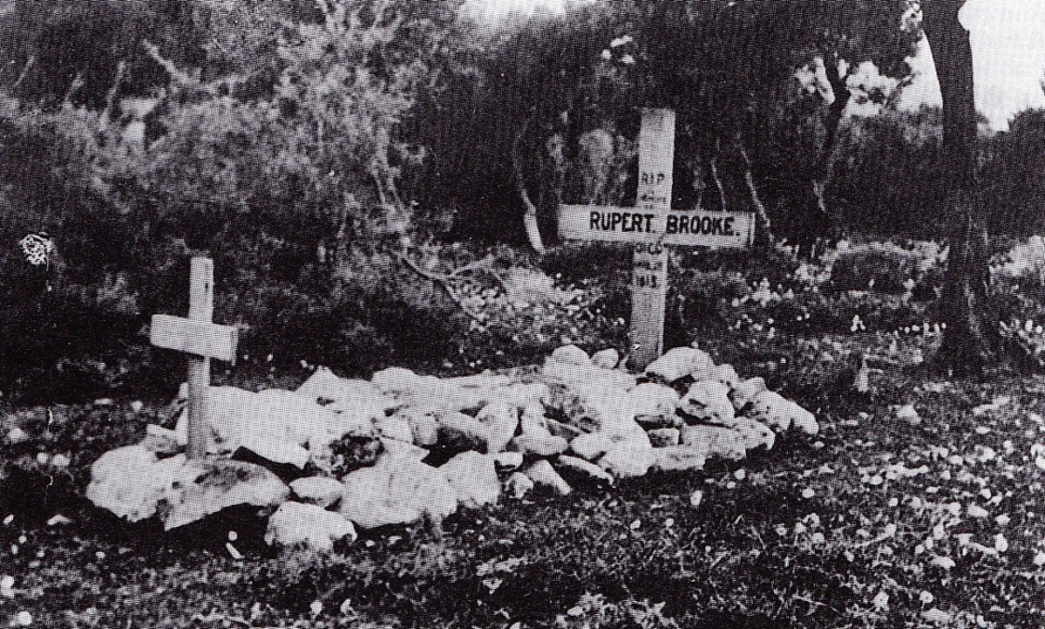
Experiences of War:
Brooke returned to England at the outbreak of war, and enlisted in The Royal Naval Division.
His entire war experience consisted of one day of limited military action during the evacuation of Antwerp.
On April 23rd, 1915, he died
of blood poisoning from a
mosquito bite while on his
way to the battle at Gallipoli.

Slide 5
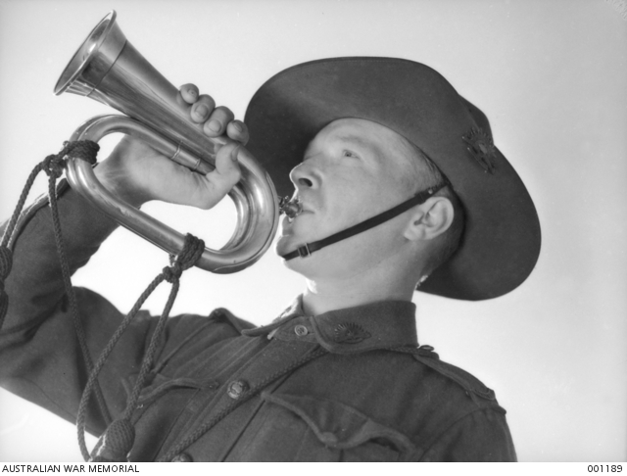
War Poetry:
It is ironic that Brooke is considered a war poet, as this entire reputation rests on only five war sonnets.
Therefore, his war poetry is full of sentiments that glorify war and it’s purpose, and celebrate the patriotic duty of those who fought and died.
Brooke was already a famous poet before the war, and he became a symbol of the loss of talented young men during the war.

