Slide 1
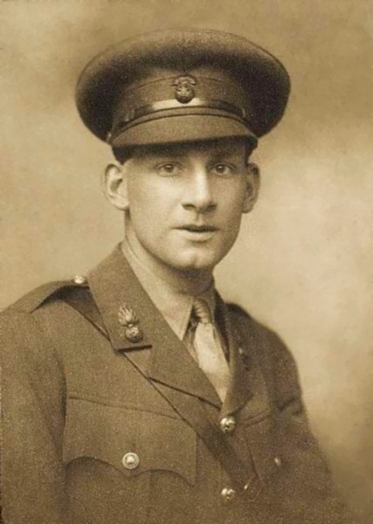
Siegfied Sassoon

Slide 2
Biography and context:
Born on September 8th 1886 in Kent, England.
Sassoon was well educated, and studied law and history at university. However, he left before graduating to pursue a career in poetry.
Before the war, he lived a life of luxury; he enjoyed fox-hunting and playing cricket.

Slide 3
World War One Experiences:
Enlisted on August 2nd 1914, and became a 2nd Lieutenant with the Royal Welch Fusiliers in May, 1915.
His brother was killed at Gallipoli in November, 1915, and another good friend was killed in March 1916. These events brought home to Sassoon the full impact of the war.
Sassoon became reckless, and would often go into No-Man’s Land to patrol on his own. He wished to attack a German patrol as revenge for the death of his brother and friends.
In June, 1916 he was awarded the Military Cross for bravery and leadership.

Slide 4
Sassoon did not fight in The Battle of the Somme, as he was sent home with trench fever. He was sent back to France in February, 1917
He was eventually wounded in the Battle of Scarpe, where a German sniper shot him between the shoulder blades.
During his time recovering , he became increasingly critical of the war and it was determined that he was suffering shell shock. He was sent to Craiglockhart War Hospital in Scotland for four months, where he wrote a great deal of anti-war poems.

Slide 5
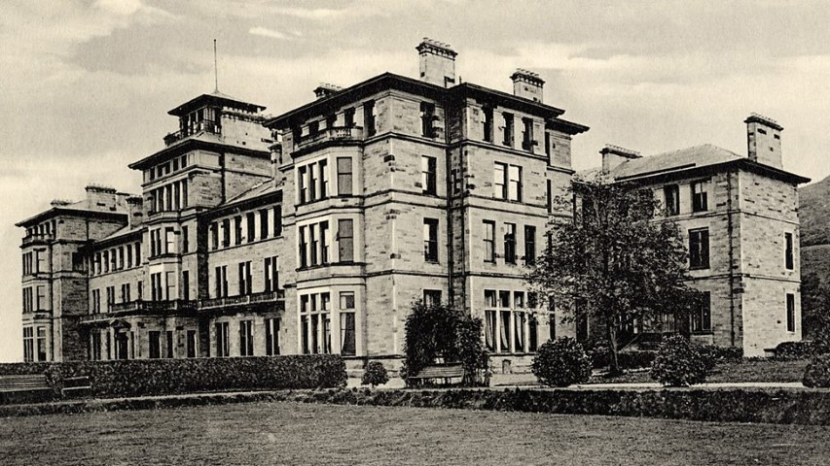
In February 1918, Sassoon returned to the war in France as a Company Commander.
He was wounded in the head in July 1918, and sent back to England with indefinite sick leave. He never saw active service again.

Slide 6
Poetry:
Most of Sassoon’s poems commented on life at home in England, where people had no idea of the horrors of war.
He was extremely critical of those he thought were profiting from the war, and also of those who commanded the army.
Sassoon’s poems are some of the best examples of anti war poetry, as they describe in detail the physical, emotional, and psychological effects of war.

