Slide 1
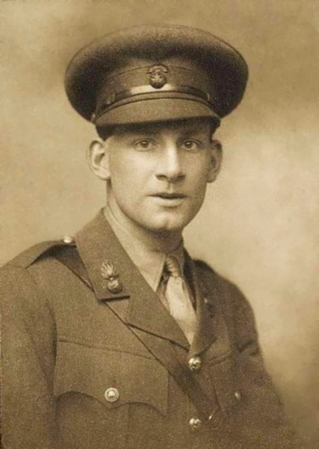
Survivors
Siegfried Sassoon (1886–1967)

Slide 2
Survivors
NO doubt they’ll soon get well; the shock and strain
Have caused their stammering, disconnected talk.
Of course they’re ‘longing to go out again,’—
These boys with old, scared faces, learning to walk.
They’ll soon forget their haunted nights; their cowed
Subjection to the ghosts of friends who died,—
Their dreams that drip with murder; and they’ll be proud
Of glorious war that shatter’d all their pride...
Men who went out to battle, grim and glad;
Children, with eyes that hate you, broken and mad.
- Craiglockart. October, 1917.

Slide 3
Survivors

Slide 4
Men who lived through the war
Living through a traumatic event or experience.
Survivors
Usually thought to be a good thing. Positive connotation of survival. Ironic when considering the themes of the poem.
Men who have returned home as heroes
Negative connotation – surviving is different to living

Slide 5
NO doubt they’ll soon get well; the shock and strain
Have caused their stammering, disconnected talk.

Slide 6
Anonymity of the subject. Returned soldiers loss of individuality. More than one.
Alliteration adds to the harshness of the sound. Direct reference to shell shock.
High modality / certainty in tone.
Matter of fact, informal.
NO doubt they’ll soon get well; the shock and strain
Have caused their stammering, disconnected talk.
Aural imagery highlights the symptoms of shell shock, damage to the nerves.

Slide 7
Of course they’re ‘longing to go out again,’—
These boys with old, scared faces, learning to walk.

Slide 8
Sassoon is using sarcasm to emphasise the voice of the public, men don’t really want to return to the Front.
Punctuation is used to create an extended pause to emphasise change in tone and voice.
High modality. Certainty of the voices of the public.
Of course they’re ‘longing to go out again,’—
These boys with old, scared faces, learning to walk.
Extends the oxymoron by reducing the men to infant stage. Highlights effects of shell shock.
Imagery of the men suffering shell shock. Emphasised by the use of oxymoron that highlights young men looking old,

Slide 9
They’ll soon forget their haunted nights; their cowed
Subjection to the ghosts of friends who died,—

Slide 10
Opinion of the public. Lack of belief in shell shock as a real illness.
Nightmares as symptom of shell shock. Imagery / Metaphor. Emotive language
They’ll soon forget their haunted nights; their cowed
Subjection to the ghosts of friends who died,—
Punctuation creates extended pause for the reader to consider the suffering. Creates a sense of guilt.
Imagery of fear emphasised through strong emotive language. Men have no control over their symptoms or their fear.
Imagery of nightmares. Provokes an emotional response.

Slide 11
Their dreams that drip with murder; and they’ll be proud
Of glorious war that shatter’d all their pride...

Slide 12
Strong emotive language in contrast to “died”. Provokes a shocked response from the audience as someone is to blame for murder.
Contrasting emotion of proud emphasises Sassoons sarcasm, and attack on public opinion.
Metaphor and alliteration provoke a harsh emotive response when compared with the previous lines.
Their dreams that drip with murder; and they’ll be proud
Of glorious war that shatter’d all their pride...
Placing of blame is emphasised through metaphor. Contrasts the emotional response of the public to the response of the survivors.
Public opinion. This is in contrast to the content and imagery provided in the poem.

Slide 13
Men who went out to battle, grim and glad;
Children, with eyes that hate you, broken and mad.

Slide 14
Alliteration and oxymoron of emotional responses when enlisting: serious but glad.
Repetition of oxymoron provides contrast of before and after war.
Men who went out to battle, grim and glad;
Children, with eyes that hate you, broken and mad.
Metaphor emphasises emotional response of the soldiers. “you” is the public or the people at home who don’t understand the experience and effects. Sassoon places definite blame here.
Negative emotive language that places direct blame on those who sent young men to war. Symptoms of shell shock, imagery of broken bodies.

Slide 15
Anonymity of the subject. Returned soldiers loss of individuality. More than one.
Matter of fact, informal.
Survivors
NO doubt they’ll soon get well; the shock and strain
Have caused their stammering, disconnected talk.
Of course they’re ‘longing to go out again,’—
These boys with old, scared faces, learning to walk.
They’ll soon forget their haunted nights; their cowed
Subjection to the ghosts of friends who died,—
Their dreams that drip with murder; and they’ll be proud
Of glorious war that shatter’d all their pride...
Men who went out to battle, grim and glad;
Children, with eyes that hate you, broken and mad.
- Craiglockart. October, 1917.
High modality / certainty in tone.
Opinion of the public. Lack of belief in shell shock as a real illness.
Alliteration adds to the harshness of the sound. Direct reference to shell shock.
Aural imagery highlights the symptoms of shell shock, damage to the nerves.
High modality. Certainty of the voices of the public.
Imagery of the men suffering shell shock. Emphasised by the use of oxymoron that highlights young men looking old.
Sassoon is using sarcasm to emphasise the voice of the public, men don’t really want to return to the Front.
Imagery of fear emphasised through strong emotive language. Men have no control over their symptoms or their fear.
Punctuation is used to create an extended pause to emphasise change in tone and voice.
Extends the oxymoron by reducing the men to infant stage. Highlights effects of shell shock.
Nightmares as symptom of shell shock. Imagery / Metaphor. Emotive language
Punctuation creates extended pause for the reader to consider the suffering. Creates a sense of guilt.
Public opinion. This is in contrast to the content and imagery provided in the poem.
Placing of blame is emphasised through metaphor. Contrasts the emotional response of the public to the response of the survivors.
Alliteration and oxymoron of emotional responses when enlisting: serious but glad.
Metaphor and alliteration provoke a harsh emotive response when compared with the previous lines.
Strong emotive language in contrast to “died”. Provokes a shocked response from the audience as someone is to blame for murder.
Negative emotive language that places direct blame on those who sent young men to war. Symptoms of shell shock, imagery of broken bodies.
Imagery of nightmares. Provokes an emotional response.
Repetition of oxymoron provides contrast of before and after war.
Metaphor emphasises emotional response of the soldiers. “you” is the public or the people at home who don’t understand the experience and effects. Sassoon places definite blame here.
Contrasting emotion of proud emphasises Sassoons sarcasm, and attack on public opinion.

Slide 16
Survivors
 | EXPLAIN | EXAMPLE
About
Themes
Emotions / Mood
Audience
Form / Style
Poetic Devices

