Slide 1
Textual
Conversations

Slide 2
Ideas to Explore
 | Power & Responsibility
 | Representation of the other
 | Revenge
 | Impact of Trauma
 | Female Agency
 | Women as Commodities
 | Imprisonment
 | Transformation
 | Motif of Performance

Slide 3
Context The Tempest
17th Century Jacobean Era
Humanism
Great Chain of Being
Political Change
Colonialism
Renaissance
The Reformation
Protestants separated themselves from the Roman Catholic church. This led to the diminishing control of religion as it became deeply personal rather than ritualistic. Another influence was that literacy was improved amongst the lower classes.
Humanism stresses the importance of human values and dignity. In the Renaissance the focus was on the development of human virtues to their fullest extent. These virtues were understanding, benevolence, compassion, mercy, prudence, fortitude, eloquence and even love for honor
The Renaissance was the period after The Dark Ages or Medieval Ages. There was a surge in education, science, art, literature, music, which resulted in a better life for people in general.
Elizabethans believed that God set out an order for everything in the universe. This was known as the Great Chain of Being. On Earth, God created a social order for everybody and chose where you belonged.
European exploration (or exploitation,) of other cultures outside of Europe.
Conquering new lands and imposing the colonizer's culture from on the native people.
War vs. peace, The role of religion in politics, legitimate vs. illegitimate princes, parliament increasingly unsupportive of the Crown.

Slide 4
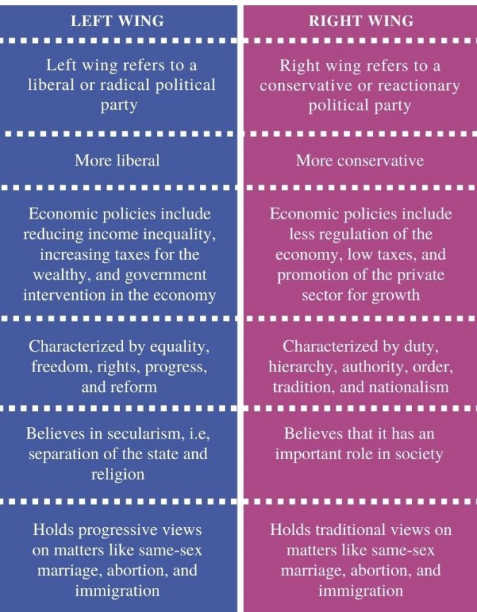
Context Hag-Seed
21st Century Canadian Western World
Post Modernism
Left Wing Politics
Institutional concerns
Popular Culture
High vs Low Culture
Hogarth Shakespeare Series
Postmodern | Modern
Subjective | Objective
No universal truths | There are universal truths that govern the world
Irony, parody, lack of seriousness | Seriousness, directness
No depth, only superficial appearances | Faith in a deeper meaning over superficial appearances
Rejects focusing on past experiences and rejects objective historical trutth | Believes in learning from past experiences and the historical record
Disney, Metallica, Lenard Cohen

Slide 5
Texts to Analyse
 | The Tempest | Hag-Seed
Genre | Tragi-Comedy Romance | Postmodern Social Commentary
Structure | Drama 5 Acts Linear Progression Epilogue | Novel Metatextual Non-linear
Narrative Voice | No Narrator – Narrated through dialogue and action | Present and past tense Limited 3rd Person Unreliable narrator
Techniques | Blank Verse/Prose Metaphor Allusion Dream motif Puns Antithesis Pathetic fallacy | Blank Appropriation Epigraph Stream—of-consciousness Magic motif Metatextuality Profanity Metaphor Reported speech

Slide 6
Characters to Compare
ARCHETYPES | THE TEMPEST | HAGSEED
Noble Hero | Prospero | Felix
Beautiful Maiden | Miranda | Anne Marie
The Innocent/The Magician | Ariel | Miranda/8Handz
Antagonist/the Malign Influence | Antonio | Tony/Snake Eye
The Flawed Ruler | Alonso | Sal/Krampus
The Lover | Ferdinand | Freddie/Wonderboy
Tragedy’s Minion | Sebastian | Sebert
The Wise Fool | Gonzalo | Lonnie/Bent Pencil
The Mistreated Villain | Caliban | All the Prisoners/Legges/Red Coyote
The Fool/Comic Relief | Stephano Trinculo

Slide 7
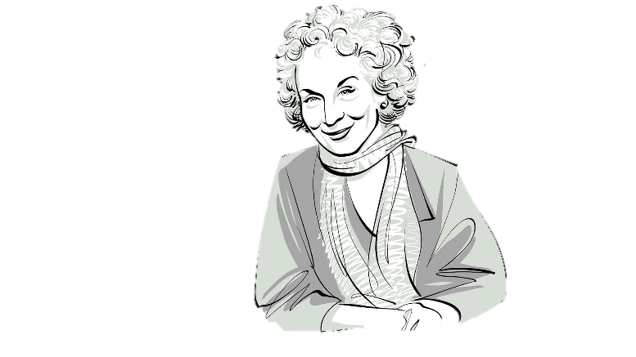
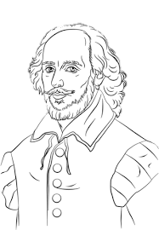
Authors to Meet
William Shakespeare
b. 1564 – d.1616
Father was a glove -maker (working class)
3 children – His only son died young
Writer, actor, poet
Lived between London and Stratford
Performed for both Queen Elizabeth I and King James I
King James favoured him.
Suspected to be (illegally) Catholic.
Peers criticized him
Margaret Atwood
b. 1932 - …
She's a Harvard dropout
Poet, Novelist.
Calls Herself a “Misguided Feminist”
frequently explore women's struggles in her novels
outspoken advocate for environmental issues
regularly speaks on the Canadian Identity
She always begins writing with a pen or pencil and paper.
She's a notorious procrastinator.
She was raised a "strict agnostic."

Slide 8
Resources
https://www.verywellmin
https://owlcation.com/humanities/Postmodernism-Explainedd.com/what-is-humanistic-psychology-2795242
https://pediaa.com/what-is-the-differe
nce-between-left-wing-and-right-wing/
https://www.britannica.com/event/Reformation
https://www.britannica.com/event/Renaissance
http://lukebartolo.blogspot.com/2019/

