Slide 1
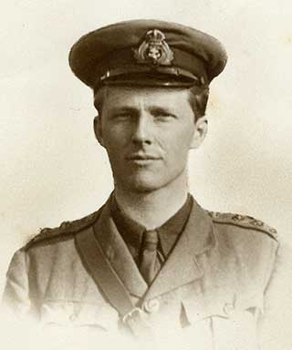
The Dead
Rupert Brooke

Slide 2
Blow out, you bugles, over the rich Dead! There’s none of these so lonely and poor of old, But, dying, has made us rarer gifts than gold. These laid the world away; poured out the red Sweet wine of youth; gave up the years to be Of work and joy, and that unhoped serene, That men call age; and those who would have been, Their sons, they gave, their immortality.
Blow, bugles, blow! They brought us, for our dearth, Holiness, lacked so long, and Love, and Pain. Honour has come back, as a king, to earth, And paid his subjects with a royal wage; And Nobleness walks in our ways again; And we have come into our heritage.

Slide 3
A poem of reverence for the sacrifice of men in war.
The Dead serve as the narrative voice of the poem.
The Dead
Not referring to an individual, but a collective loss of lives.
Brooke provides the public with a final message of patriotism from the dead soldiers.

Slide 4
Blow out, you bugles, over the rich Dead! There’s none of these so lonely and poor of old,

Slide 5
The poem opens with a directive, ordering respect be paid. Bugles are traditionally sounded at military funerals
The dead are highly valued, as shown through metaphor, as well as punctuation. Start of extended metaphor.
Blow out, you bugles, over the rich Dead! There’s none of these so lonely and poor of old,
Men who were once poor, are now rich in death. Contrast of the value in life and the value in death.

Slide 6
But, dying, has made us rarer gifts than gold.

Slide 7
This is the direct voice of the dead, Brooke is speaking for them
Extended metaphor adds value to the deaths.
But, dying, has made us rarer gifts than gold.

Slide 8
These laid the world away; poured out the red Sweet wine of youth; gave up the years to be Of work and joy, and that unhoped serene,

Slide 9
Metaphor describes how the men put their own lives aside to die for their country.
Metaphor / imagery describes how in death, youth is used up like wine. Imagery relates to the red of wine. Poured suggests ease.
Shows willingness
These laid the world away; poured out the red Sweet wine of youth; gave up the years to be Of work and joy, and that unhoped serene,
Peace in old age. Emotive language.
Future prospects now denied to the dead.

Slide 10
That men call age; and those who would have been, Their sons, they gave, their immortality.

Slide 11
In death they have been denied a future.
That men call age; and those who would have been, Their sons, they gave, their immortality.
In death they no longer have hope of metaphorical immortality as they will have no family line.
The future is represented through metaphorical sons. The dead will have no future family.
Willingness, a gift to be honoured.

Slide 12
Blow, bugles, blow! They brought us, for our dearth, Holiness, lacked so long, and Love, and Pain.

Slide 13
Dearth means inadequate. The soldiers’ deaths have provided their country with what was lacking.
Shift in perspective - Brooke is now speaking about the dead, not for them.
Repetition emphasises the tone of respect.
Blow, bugles, blow! They brought us, for our dearth, Holiness, lacked so long, and Love, and Pain.
Start of religious extended metaphor. The dead have brought faith back to Britain
Capital letters make these terms personification, as the dead are bringing these things to the living.

Slide 14
Honour has come back, as a king, to earth, And paid his subjects with a royal wage;

Slide 15
Extended religious metaphor, comparing the gifts of the dead to the gift of Christ’s resurrection.
Simile comparing the dead to nobility.
Personification
Honour has come back, as a king, to earth, And paid his subjects with a royal wage;
Extended wealth metaphor. The sacrifice of the dead is worthy for King and Country.

Slide 16
And Nobleness walks in our ways again; And we have come into our heritage.

Slide 17
Personification. Nobility has returned because the soldiers have displayed chivalry in dying for their country.
And Nobleness walks in our ways again; And we have come into our heritage.
Metaphor. The deaths were worth it because Britain is now a noble and proud country like its heritage suggests. The dead have brought honour back.

Slide 18
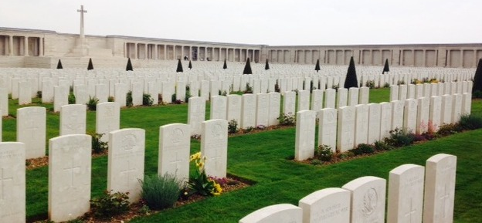
The Dead is a sonnet, even though it has no rhyming couplet at the end.
The Octet (first 8 lines) deal with what the soldiers have lost through death.
The Sestet (next 6 lines) is about what the world, specifically Britain, has gained from their deaths.

Slide 19
Answer the following questions, using full sentence answers:
What is Brooke’s opinion of the purpose of fighting the war?
2. How does this differ from the opinion of Siegfried Sassoon?
3. Why would Brooke’s opinion be so different? Consider the difference in contexts of the poets.
4. Identify and explain the TWO extended metaphors in the poem. What purpose do they serve?

Slide 20
The Dead
 | EXPLAIN | EXAMPLE
About
Themes
Emotions / Mood
Audience
Form / Style
Poetic Devices

Slide 21
The poem opens with a directive, ordering respect be paid. Bugles are traditionally sounded at military funerals
The dead are highly valued, as shown through metaphor, as well as punctuation. Start of extended metaphor.
This is the direct voice of the dead, Brooke is speaking for them
Men who were once poor, are now rich in death. Contrast of the value in life and the value in death.
Extended metaphor adds value to the deaths.
Metaphor describes how the men put their own lives aside to die for their country.
Blow out, you bugles, over the rich Dead! There’s none of these so lonely and poor of old, But, dying, has made us rarer gifts than gold. These laid the world away; poured out the red Sweet wine of youth; gave up the years to be Of work and joy, and that unhoped serene, That men call age; and those who would have been, Their sons, they gave, their immortality.
Blow, bugles, blow! They brought us, for our dearth, Holiness, lacked so long, and Love, and Pain. Honour has come back, as a king, to earth, And paid his subjects with a royal wage; And Nobleness walks in our ways again; And we have come into our heritage.
Metaphor / imagery describes how in death, youth is used up like wine. Imagery relates to the red of wine. Poured suggests ease.
Future prospects now denied to the dead.
Shows willingness
The future is represented through metaphorical sons. The dead will have no future family.
Peace in old age. Emotive language.
In death they have been denied a future.
Willingness, a gift to be honoured.
Repetition emphasises the tone of respect.
In death they no longer have hope of metaphorical immortality as they will have no family line.
Shift in perspective - Brooke is now speaking about the dead, not for them.
Start of religious extended metaphor. The dead have brought faith back to Britain
Dearth means inadequate. The soldiers’ deaths have provided their country with what was lacking.
Personification
Capital letters make these terms personification, as the dead are bringing these things to the living.
Simile comparing the dead to nobility.
Extended religious metaphor, comparing the gifts of the dead to the gift of Christ’s resurrection.
Personification. Nobility has returned because the soldiers have displayed chivalry in dying for their country.
Extended wealth metaphor. The sacrifice of the dead is worthy for King and Country.
Metaphor. The deaths were worth it because Britain is now a noble and proud country like its heritage suggests. The dead have brought honour back.

