Slide 1
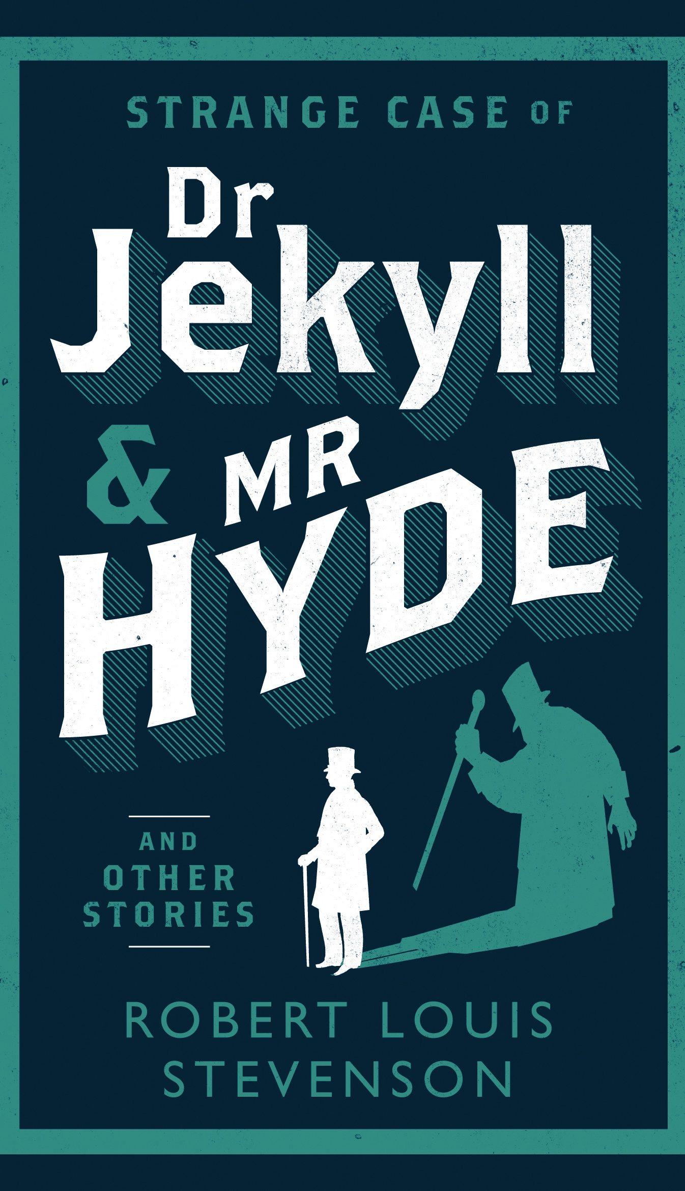
CONTEXT of THE NOVEL

Slide 2
The Novel
Written in 1886
By Robert Louis Stephenson
Set in London
It is a novella (short novel)
It is written in the third person but focuses on a lawyer called Mr. Utterson.
The writer uses letters and diaries to give different viewpoints.
The genre is both a horror story about supernatural events and a detective fiction about finding a criminal and solving a mystery.

Slide 3
Aspects of Context: Add notes to your mindmap
Social context:
Victorian society and values
Hypocrisy and dual lives
Crime
Science and religion
Psychology
Victorian London
Literary Context
Horror fiction
Crime fiction
ASPECTS THAT MAKE UP THE CONTEXT

Slide 4
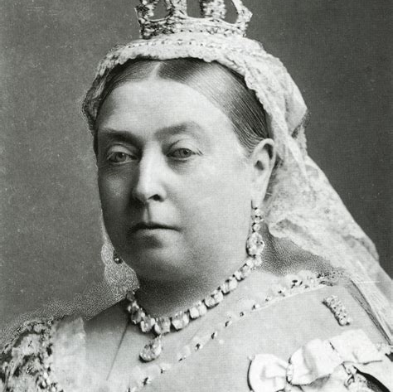
Queen Victoria
Victoria (Alexandrina Victoria; 24 May 1819 – 22 January 1901) was Queen of the United Kingdom of Great Britain and Ireland from 20 June 1837 until her death.
From 1 May 1876, she adopted the additional title of Empress of India.

Slide 5
Victorian London
During the 19th century, London became the world's largest city and capital of the British Empire. Its population expanded from 1 million in 1800 to 7 million in 1900.
In the Victorian era, London became a global political, financial, and trading capital. In this position, it was largely unrivalled until the latter part of the century, when Paris and New York City began to threaten its dominance.
London was a city of great contrasts. While the city grew extremely wealthy as Britain’s trade and Empire expanded, 19th century London was also a city of poverty, where millions lived in overcrowded and unsanitary slums.

Slide 6
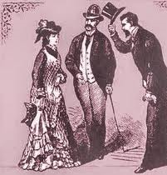
Victorian Society
Victorian gentleman and ladies had to live by strict rules about what was proper.
A lady or gentleman’s reputation was very important. It was important to appear to live a decent, Christian life.
Manners, dress, behaviour had to conform to society’s expectations.
Sex was only to take place within marriage. It was never spoken of in polite company.
Victorians are often seen as ‘prudish’ – easily shocked by words which might suggest something even vaguely sexual.
https://www.youtube.com/watch?v=_8oyQRabV9k&index=12&list=PL31KgkgYdVbFnusfukX6F-vq_LcZGXUFk

Slide 7
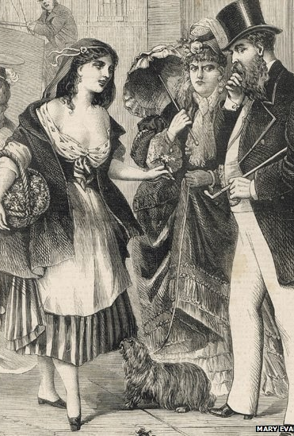
Hypocrisy and Dual Lives
In fact, many Victorian men led secret immoral lives.
There were thousands of prostitutes in London whose clients were men of all social classes.
Drinking, gambling, and prostitution were widespread, particularly in the poorer parts of London.
The sexually transmitted disease syphilis was very common and could not be cured. Men could transmit it to their wives and infected women would pass it on to their unborn babies.

Slide 8
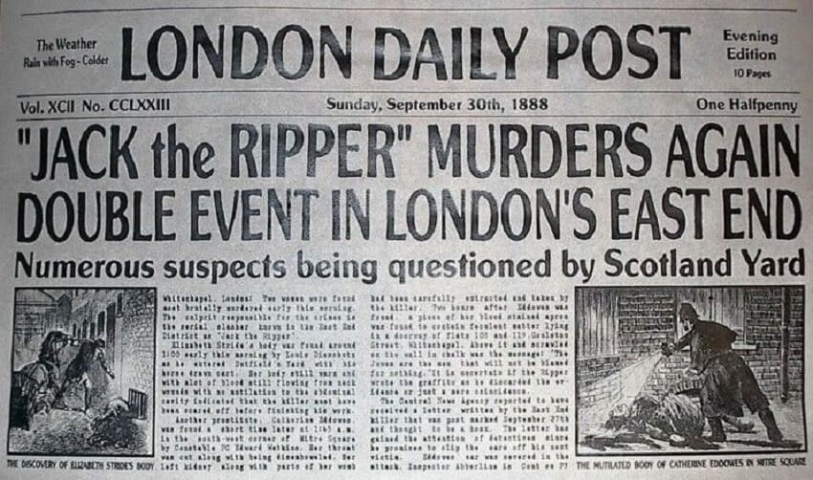
Crime
Victorians feared crime and were fascinated by it.
‘Shilling Shockers’ were stories written for upper class women about the shocking behaviour of the lower classes.
True life crime stories were also widely circulated.
Victorians were fascinated by the grisly murders of East End prostitutes by a killer known as ‘Jack the Ripper’. He was never caught. Many people believe he was a rich, even royal gentleman.

Slide 9
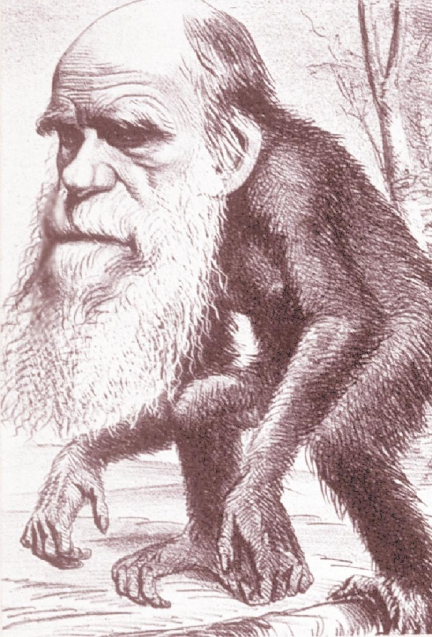
The Victorian era was the time of great scientific discovery and technological advances. Charles Darwin challenged Christianity with his theory of evolution and was widely ridiculed for it. He proposed that human beings were not created in God’s image but evolved from apes.
Science and Religion
Notes:
Consider talking about:
Upper class values

Slide 10
Some Victorians believed that scientists could go too far. They might believe that they could challenge God’s power. Scientists might be tempted to tamper with nature and this could lead them away from God and into evil.
Science and Religion
Notes:
Consider talking about:
Upper class values

Slide 11
Science
In 1859, when Stevenson was nine years old, Charles Darwin published The Origin of Species. This book became famous for introducing the Theory of Evolution to the public. Many people saw it as an attack on religion, because the book made it impossible to believe that God created the world in seven days.
Darwin put forward the theory that all life, including humans, has evolved from more primitive forms. A lot felt they had to choose between the two. And many believed that science had become dangerous and was meddling in matters which only God had control over.

Slide 12
Psychology
Closely linked to the Victorians' increasing sense of the conflict between science and religion was the idea that humans have a dual nature. On the one hand, they saw the calm, rational, everyday normality of family life and employment; on the other, fantasies, nightmares, anger and violence.
The notorious Jack the Ripper murders occurred in London in 1888. In the minds of the Victorians, they underlined the Jekyll and Hyde duality of human nature, especially as there was discussion about the murderer being highly educated, or even of royal birth.
The idea of the savage nature of humans bound within civilisation later became extremely famous by Freud (1856-1939)

Slide 13
Features of Gothic fiction
Things which are hidden
Dark, gloomy settings
Tales, journals, diaries
Dreams
Secrets
Horror and terror
Doubles or evil ‘familiars’
Mirrors
Labyrinths
Forbidden knowledge
Strange and eerie things
Darkness, fog and confusion
Supernatural

Slide 14
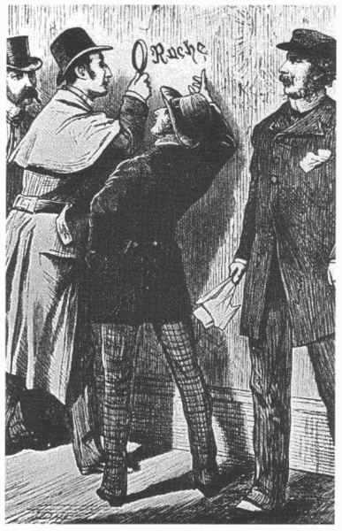
Mystery/Crime/Detective fiction
False leads and red herrings
Murder
Several possible suspects
A detective
Evidence and clues for the reader
Search for the truth
A revelation
Mistaken identity
Detailed references to dates / times etc
A final twist
A confrontation and solution
Secrets

Slide 15
Add these key words and ideas to your mind map
Victorian London: rich/poor, powerful growing city
Victorian society and values: prudish, reputation, sexually repressed
Hypocrisy and dual lives: prostitution, syphilis, gambling,
Science and religion: Darwin, challenge to religion, fear of science – too far
Crime: fascinated by crime, feared criminals, Jack the Ripper
Gothic fiction: supernatural, frightening
Crime fiction: a mystery, criminal uncovered, a detective.
IN SUMMARY

Slide 16
TO CONSIDER:
Do humans have a drive towards self destruction?
Where is destructive behaviour evident today?
How do individuals/society deal with their destructive impulses?

