Slide 1
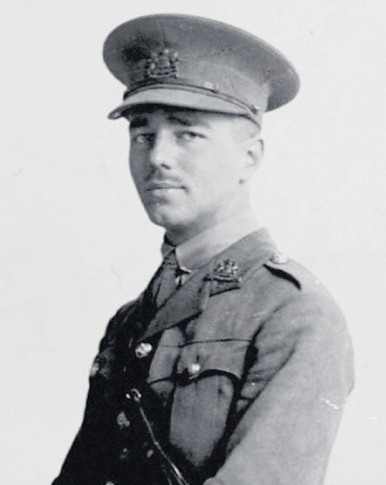
Wilfred Owen
1893 - 1918

Slide 2
Early Life:
Born in Shropshire, England. Wilfred Owen was well educated.
From the age of nineteen Owen wanted to be a poet and immersed himself in poetry, he was impressed by the Romantic poets. However, he wrote almost no poetry of importance until he saw action in France in 1917.
He was a committed Christian and became an assistant to a vicar during 1911-1913. He taught Bible classes and led prayer meetings – as well as helping in other ways.
From 1913 to 1915 he worked as a language tutor in France.

Slide 3
War Experiences:
Owen felt pressured by the propaganda to become a soldier, and volunteered on 21st October 1915.
He spent the last day of 1916 in a tent in France joining the Second Manchesters. He was full of boyish high spirits at being a soldier.
Within a week he had been transported to the front line in a cattle wagon and was "sleeping" 70 or 80 yards from a heavy gun which fired every minute or so. He was soon wading miles along trenches two feet deep in water.

Slide 4
Within a few days he was experiencing gas attacks and was horrified by the stench of the rotting dead; his sentry was blinded, his company then slept out in deep snow and intense frost till the end of January. That month was a profound shock for him: he now understood the meaning of war.
These experiences are directly related to his poem ‘Exposure’, which is one of his many descriptive poems about the horrors of war.
He escaped bullets until the last week of the war, but he saw a good deal of front-line action: he was blown up, concussed and suffered shell-shock.
At Craiglockhart, the psychiatric hospital in Edinburgh, he met Siegfried Sassoon who inspired him to develop his war poetry.

Slide 5
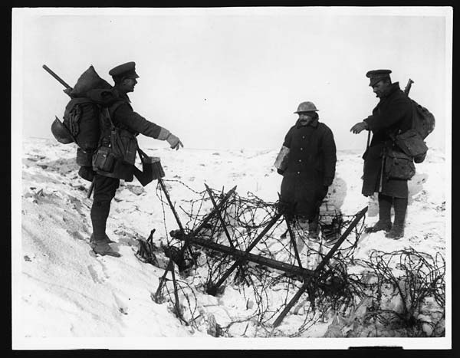
He was sent back to the trenches in September, 1918 and in October won the Military Cross by seizing a German machine-gun and using it to kill a number of Germans.
On 4th November he was shot and killed near the village of Ors.
The news of his death reached his parents home as the Armistice bells were ringing on 11 November.

Slide 6
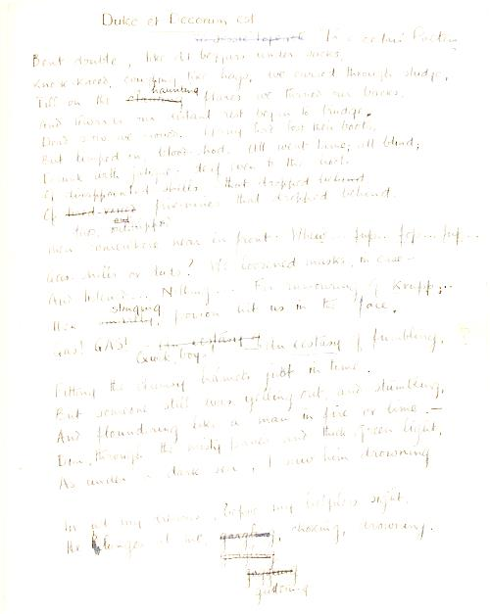
Legacy:
Wilfred Owen is perhaps one of the most highly regarded of the World War One poets.
His poems reflect the horrors of war, and the futile and tragic loss of young lives as a consequence of war.
His poems are still widely studied, and a selection of them are studied as part of the HSC Standard English course due to their literary and cultural significance.

